Slide 1
Mount Wilson Capital
BY MJMCA Incorporated
(Moshe Josh Max Clauria Alex Incorporated)

Slide 2
Mount Wilson Capital, a hard money lender
Who is Mount Wilson Capital:
EERD Schema:
Schema and how it was implemented:
Work distribution:

Slide 3
Mount Wilson Capital
A Hard Money lender:
Hard money lenders typically take on loans for people who can’t get a loan from the banks.
Requested DB and GUI for storing applicant info
Also requested employee info storage
Would retrieve requested info on employees and clients

Slide 4
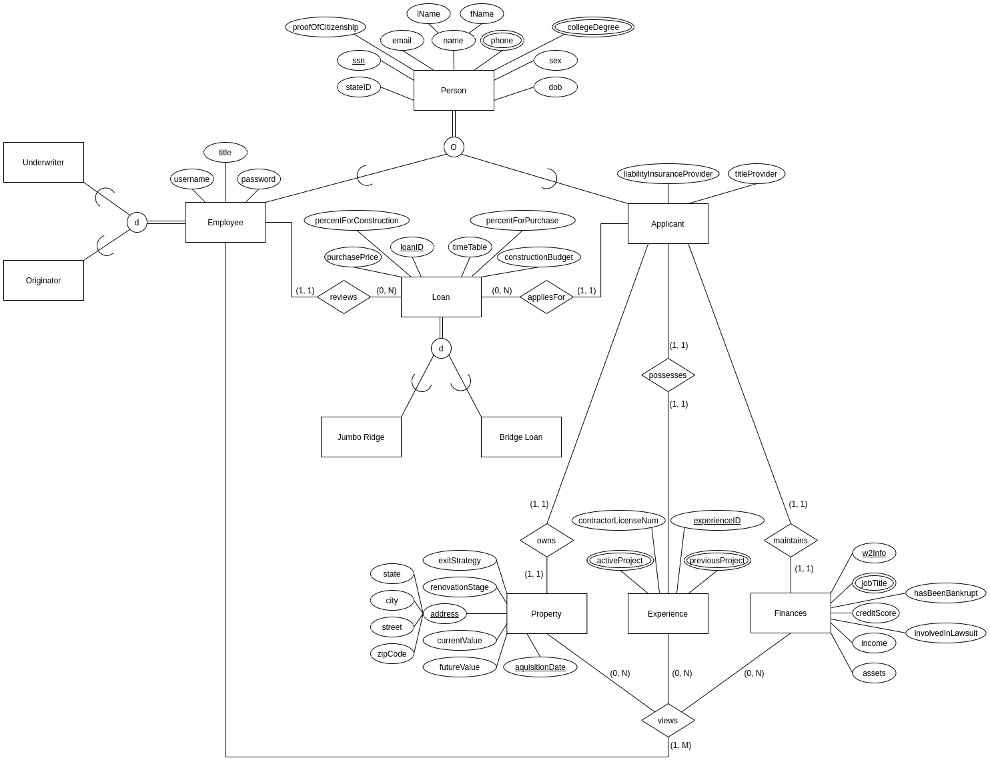
EERD for Mount Wilson capital

Slide 5
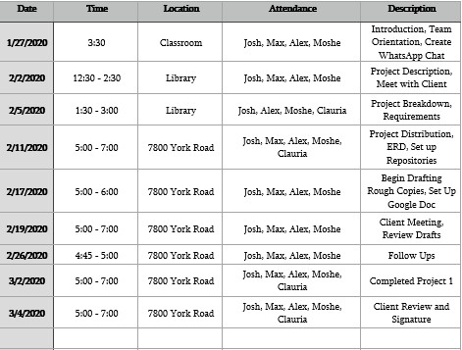
Work Distribution
Max and Moshe were in charge of and worked on the front-end GUI to implement the queries
Clauria, Alex and I were in charge of and worked on the database and queries.
Documentation was done by everyone throughout the semester

Slide 6
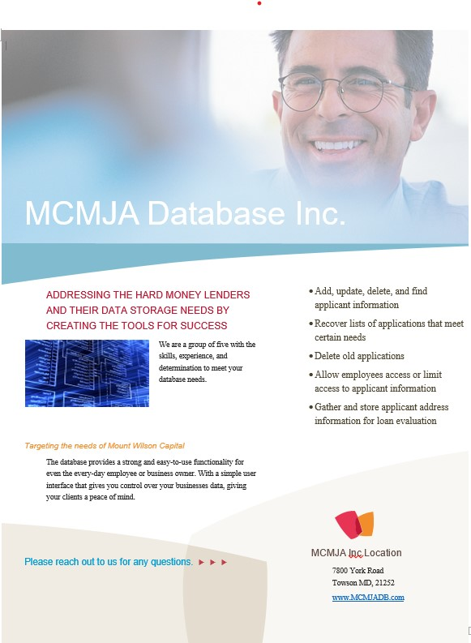
MJMCA Inc. pamphlet

Slide 7
Queries expected/requested
Find details on individuals credit score
Find details of individuals related job experience if not null
Generated list of employees and their hours
Generate list of accepted loan requests
Generate list of rejected applicants
Generate list of undecided loan applicants
Find details related to time remaining for loan terms
Find related details on possible risk for undecided applicants
Find details to conduct background checks necessary for loan
Generate list of all Previous projects
Generate list of all Profit margins
Find previous project term length
Find profit margin from a previous project
Generate list of all positive profit margins from all previous projects
Generate List of all Previous project term lengths

Slide 8
Now to the presentation of the database
By Maximilian Moore
STAND BY

